Slide 1





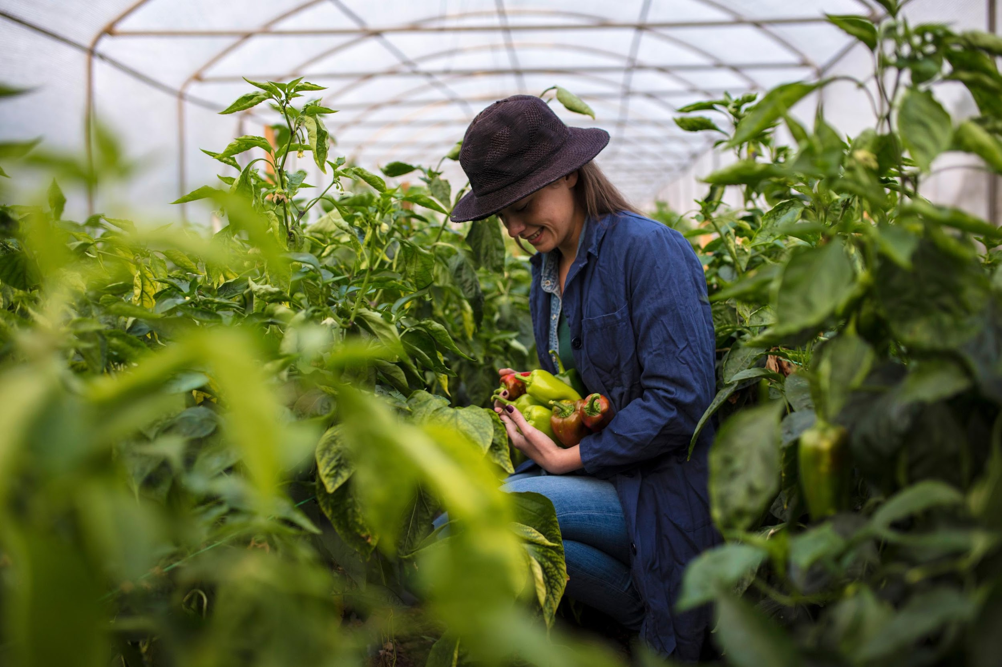

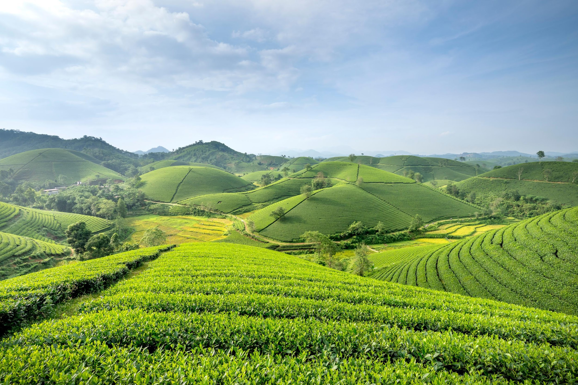


Agri Marketplace and
Community

Slide 2

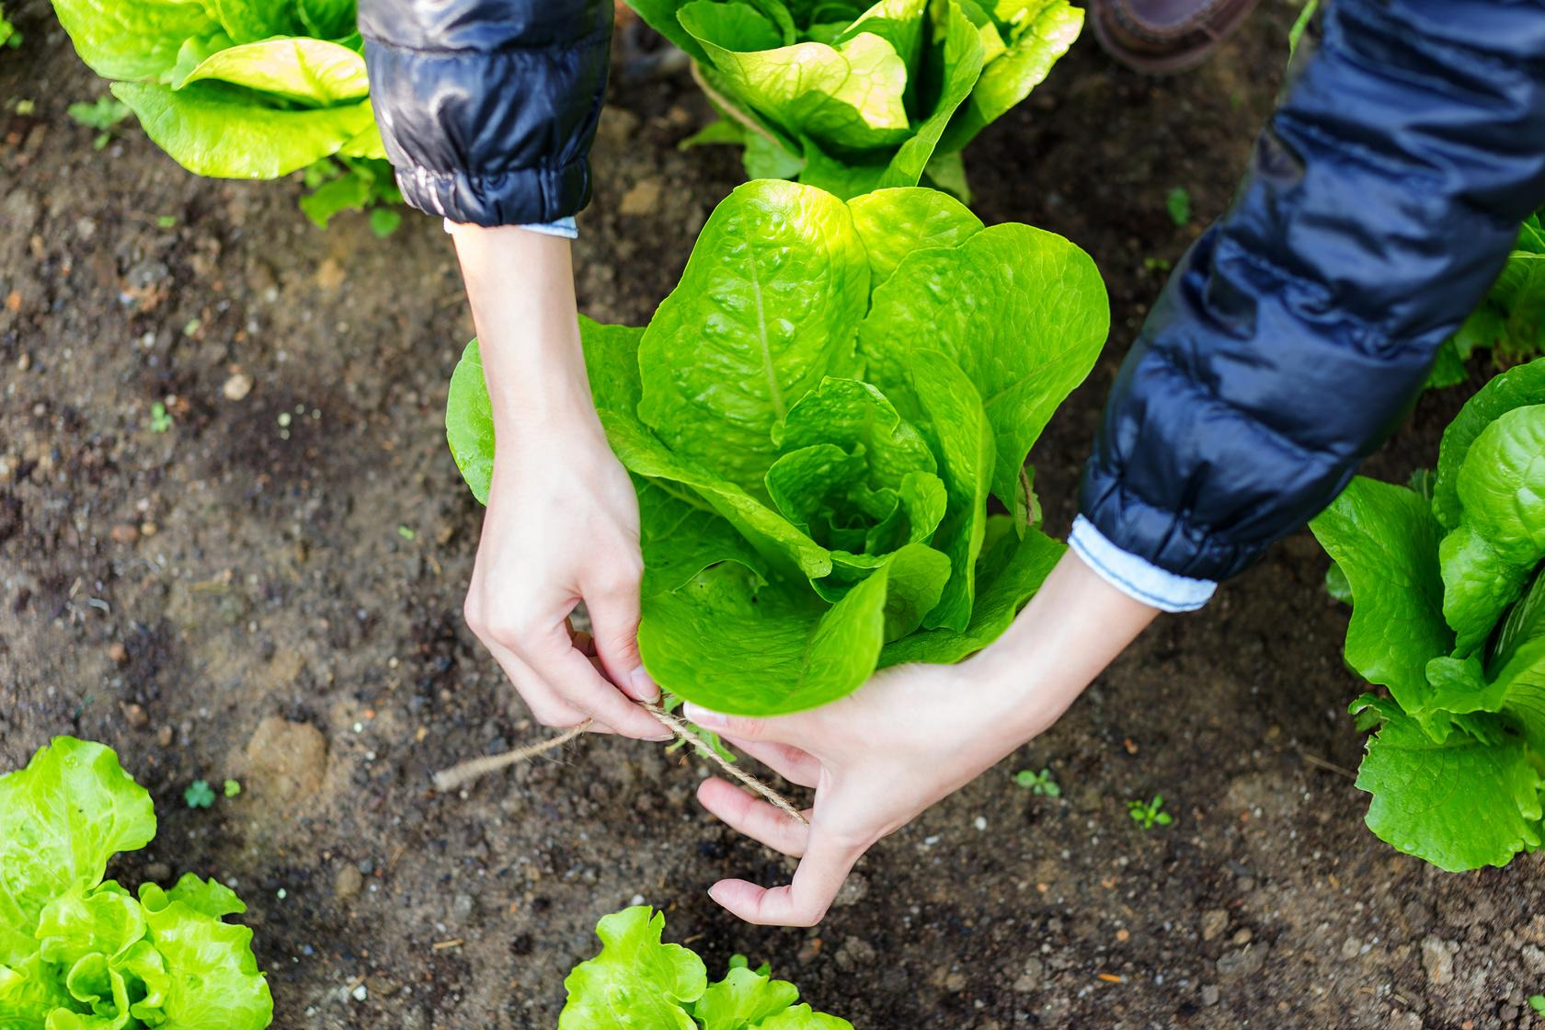
2
Presented By:
Md. Kamrul Hasan (1418)
Md. Kibria hossen Roni (1430)
Supervised By:
Dr. Md. Nurul Ahad Tawhid
Assistant Professor,
IIT, DU
Importanc of the Agricultural Sector

Slide 3
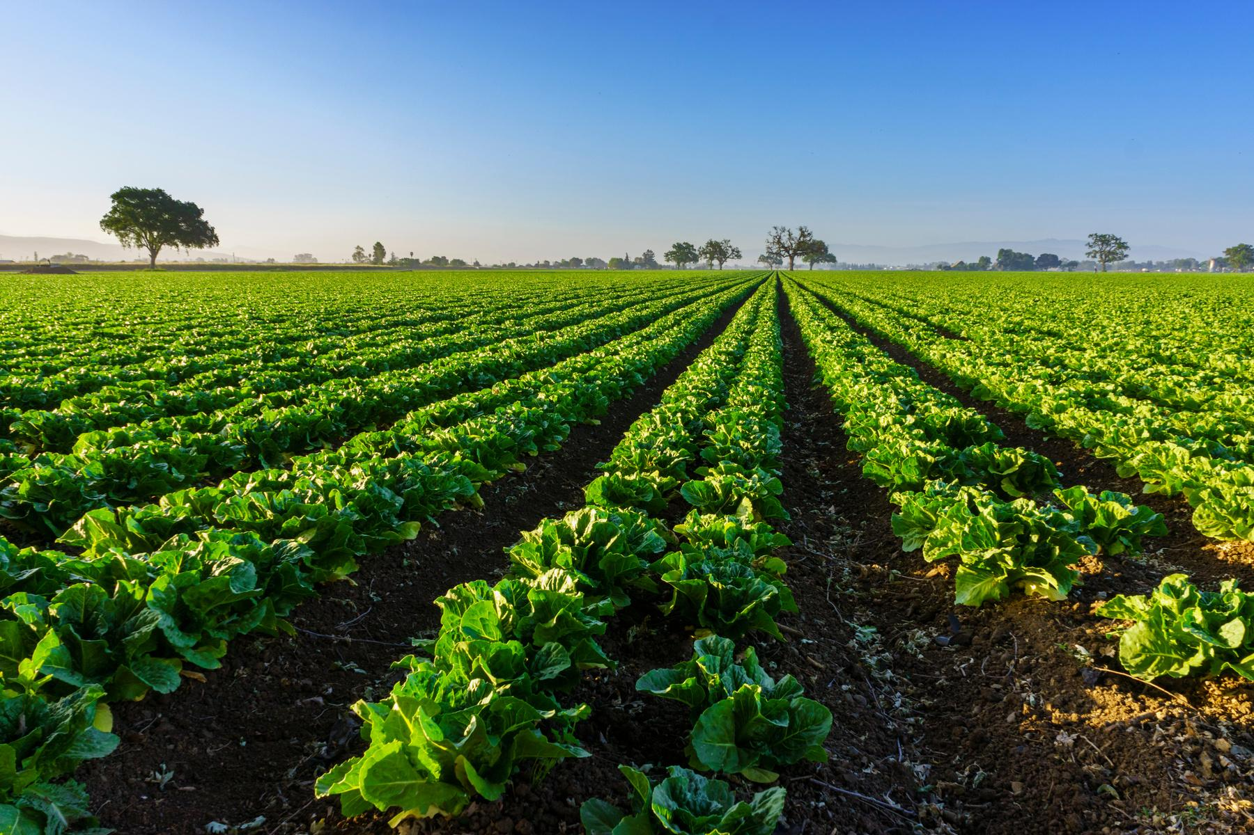
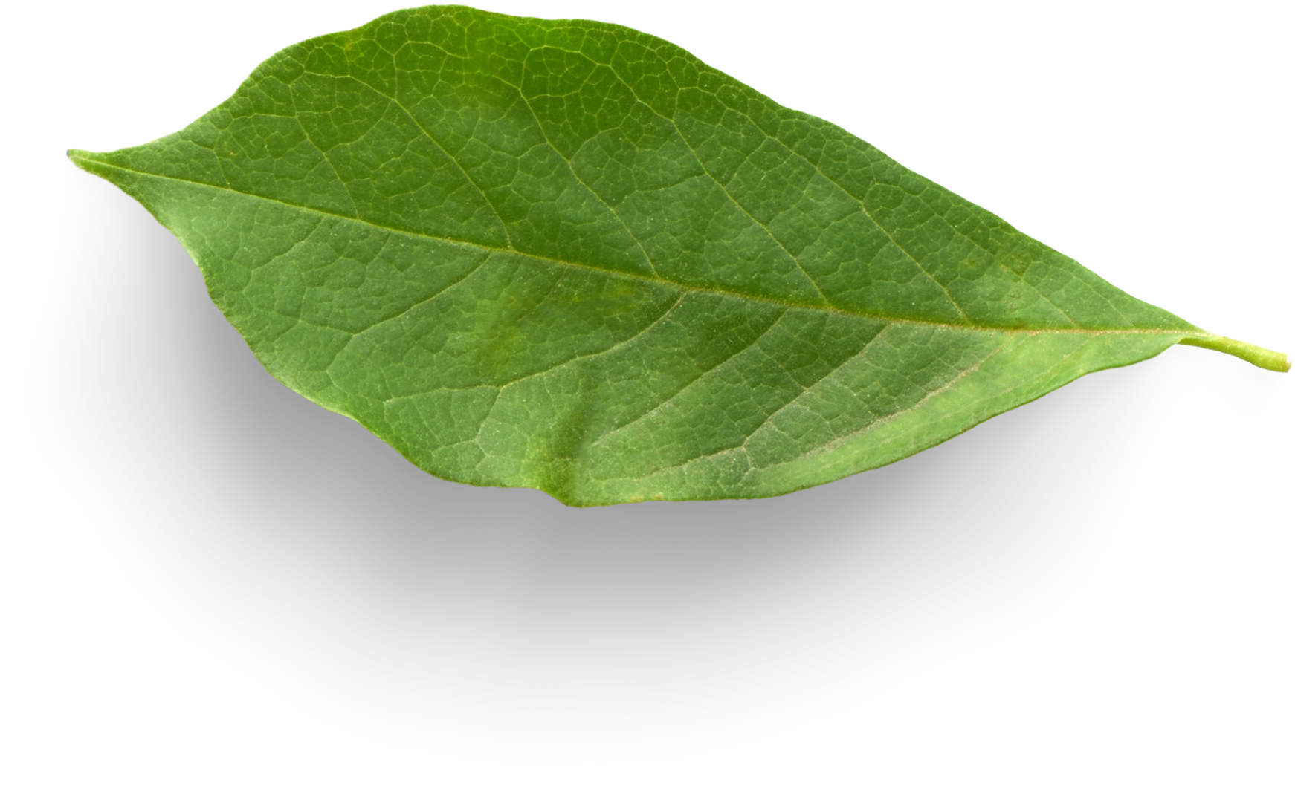
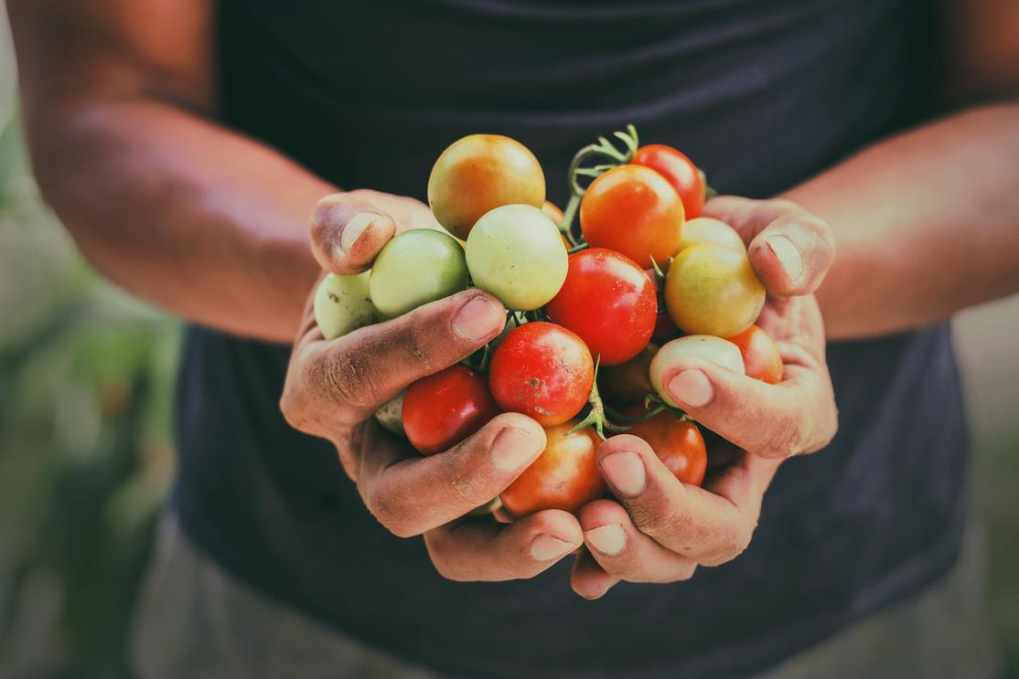
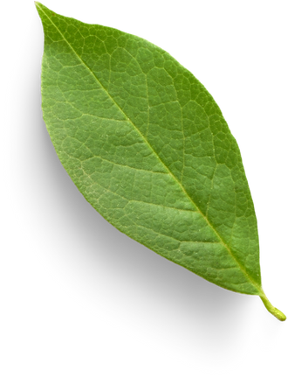

3
Background
Organic farming is not just trend, it’s the future of agriculture (UNDP)
Organic agriculture is practised in 191 countries (UNDP)
The global organic farming area increased by over 20 million hectares in 2022

Slide 4
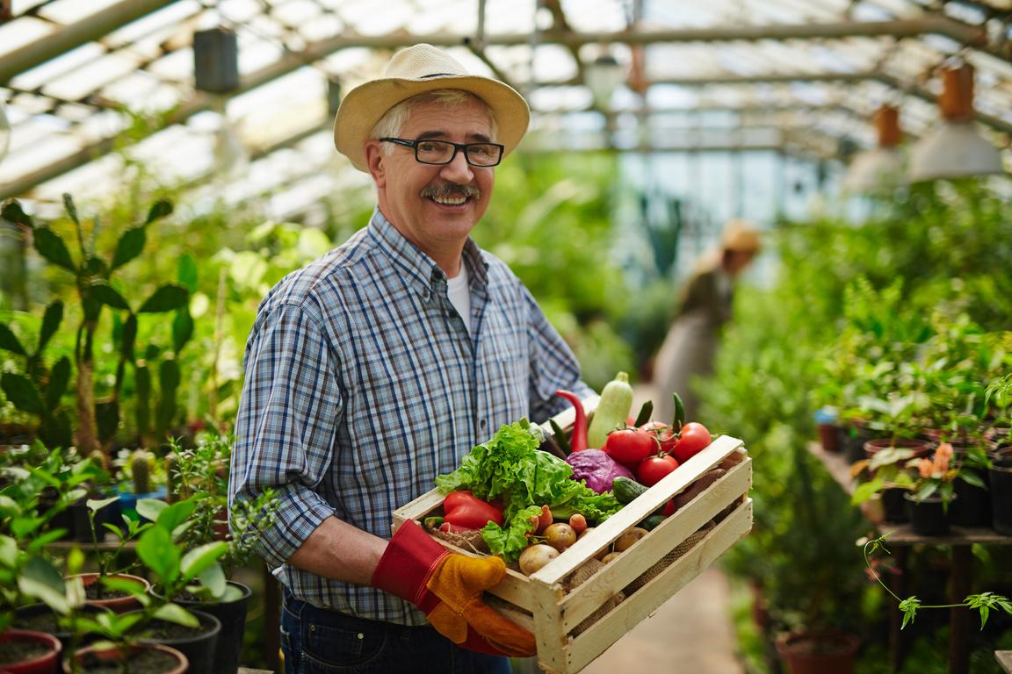


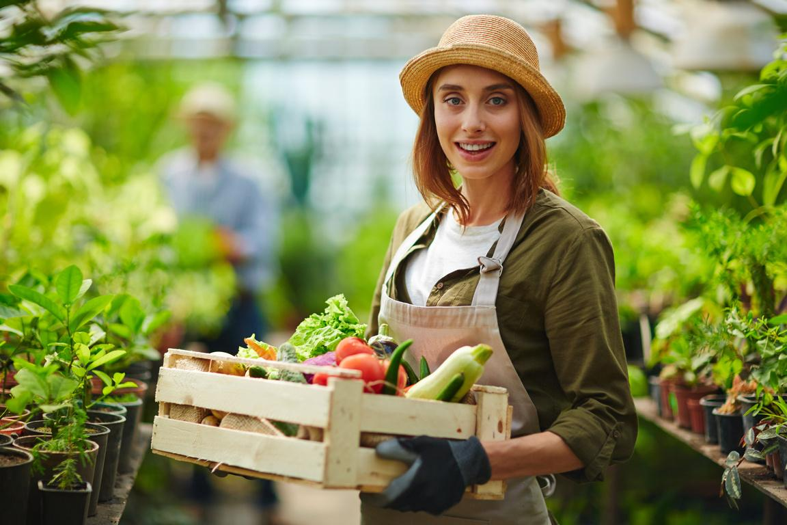


4
The
Problem
Farmer Side
“Organic farmers do not find sufficient customers to sell their product .”
Consumer Side
“Health-conscious consumers do not find organic products.”

Slide 5
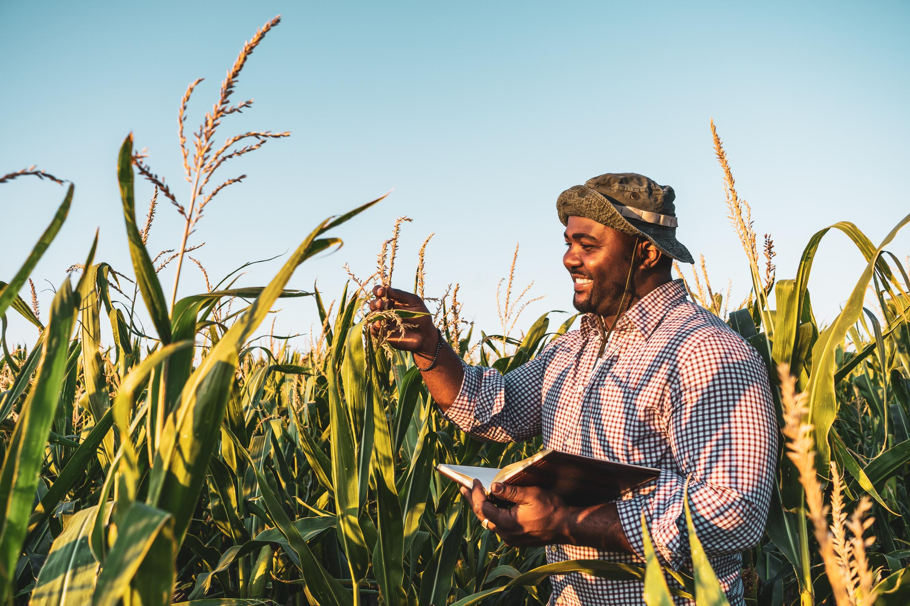
5
Our Vision
Making a bridge between two communities of health-conscious consumers and organic farmers.

Slide 6

6
Our Goals
01.
03.
Promoting Organic
Farming
Facilitate Direct Farm-to-Consumer Sales
Improve Accessibility to Healthy Food
Support Local Economies
04.
02.

Slide 7




7
Description
Separate Account for Farmer and Customer
Product Presentation and
Description
Searching and Filtering
Order and Payment
Community Forum

Slide 8

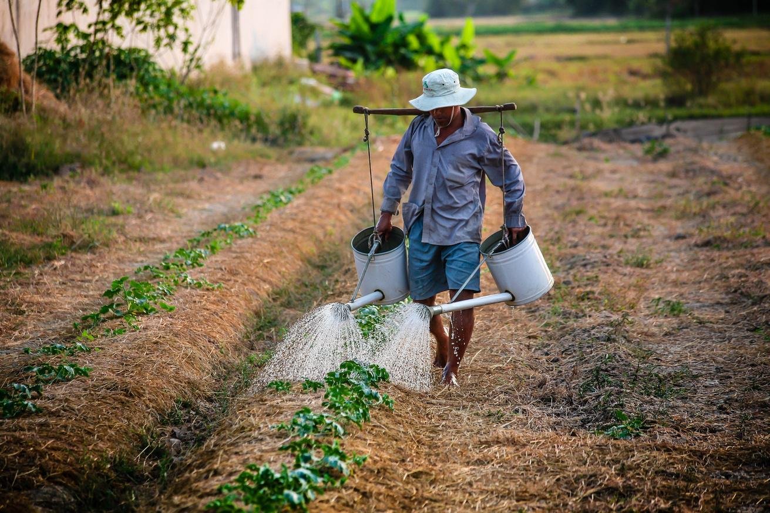
8
Challenges
Multitype user and role management
.
Payment integration and security
Delivery and logistics management
Proving uniqueness from other e-commerce platform

Slide 9



9
Technology
Frontend: HTML, CSS, Javascript
React/Angular
Backend: Python, Django
Database: MongoDB/ PostgreSQL

Slide 10
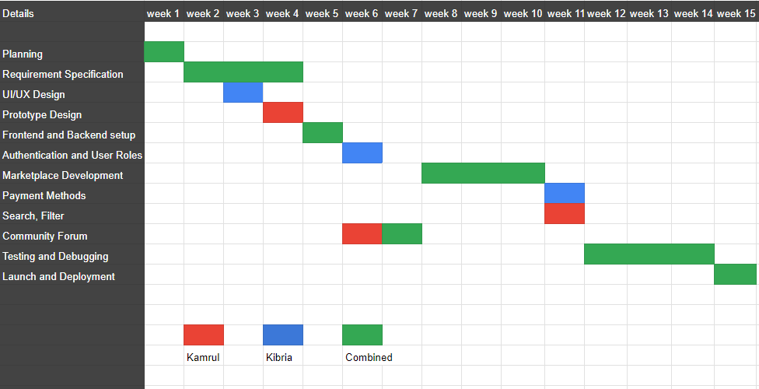
Strategy and Timeline
10

Slide 11

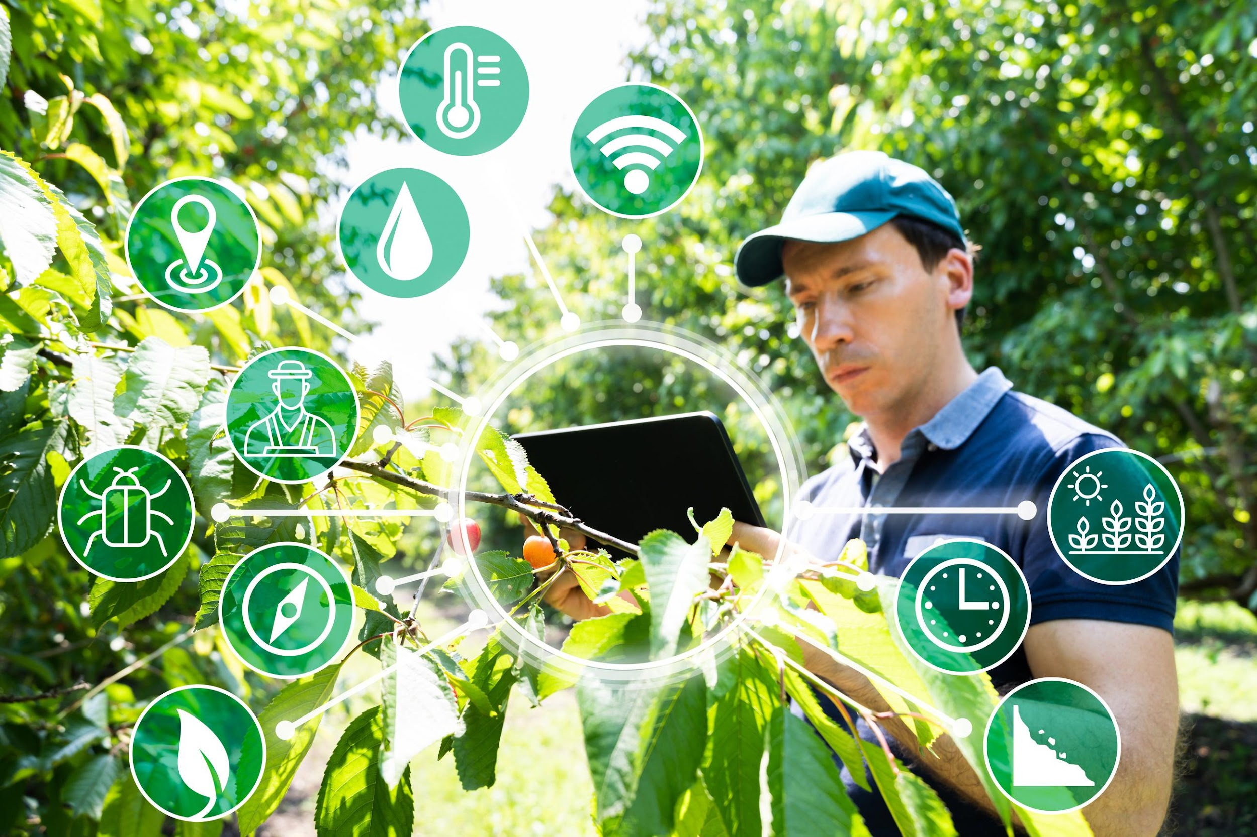
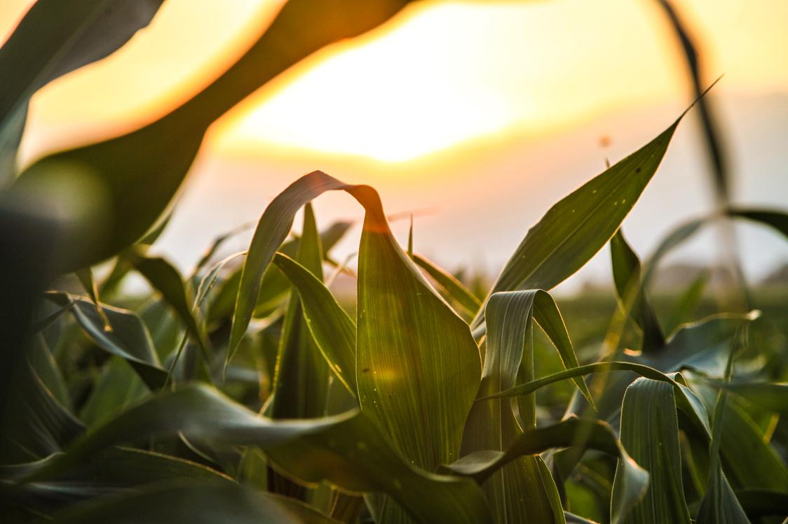
111
Thank You
For your attention

